Slide 1

A LoRa Relay Based System for Messaging in Underground Mines
Swinburne University of Technology
COS60011 – Technology Design Project
Presented by
Peili Xu – 105287345
Cain Tavares – 104683955
Nishant Maxie Carvalho – 105015672
Om Babbar – 104973737

Slide 2
Outline
Introduction
Individual Contribution
Results
Conclusion
QnA Session

Slide 3
Introduction
Background- Challenges in Underground Mining:
Terrain Interference and Dense Rock Formation
LoRa's Advantage (CSS)
Importance in Mining
Project Overview
Objective: Develop a LoRa-based messaging system for underground mining, focusing on secure, real-time communication.
Key Features
Stream cipher encryption for message security.
Graphical User Interface (GUI) for managing message transmission and reception.

Slide 4
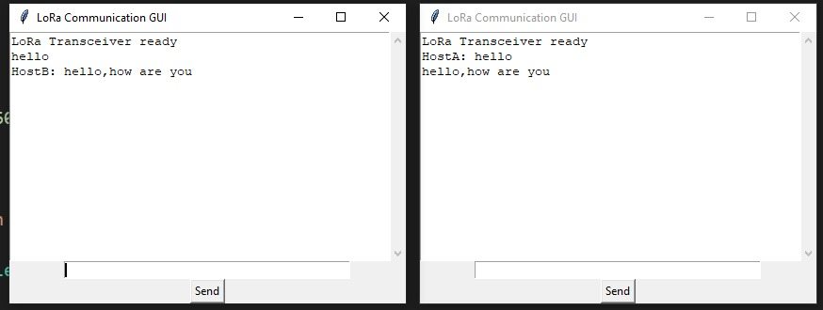
Graphical User Interface

Slide 5
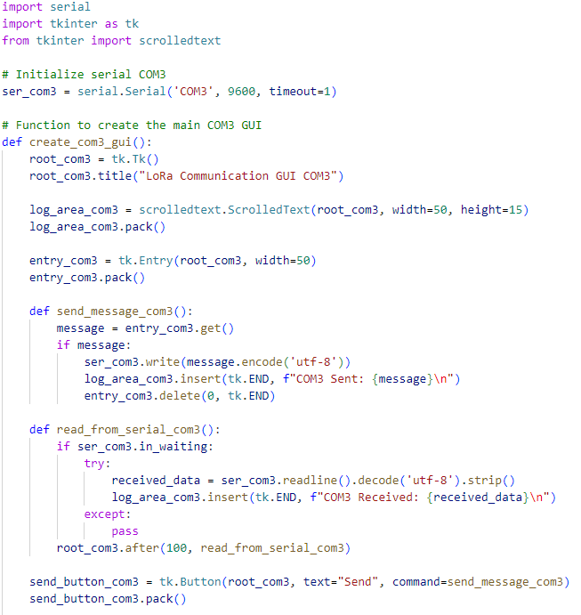
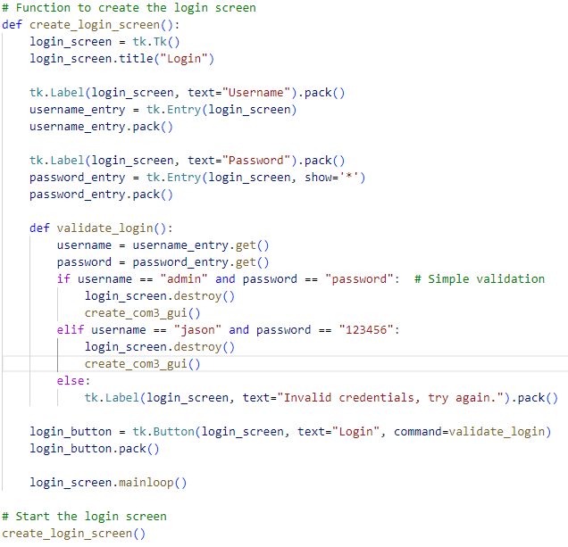

Slide 6
Algorithm
RC4 (Rivest Cipher 4) is a symmetric stream cipher designed by Ron Rivest in 1987. Here we choose RC4 because it is small and requires little memory and processing power, it is a good fit for the Arduino Uno's limited resources when it comes to encryption. Its simplicity and stream cypher nature make it suitable for LoRa communication in restricted settings, since it provide simple implementation and real-time data encryption.

Slide 7
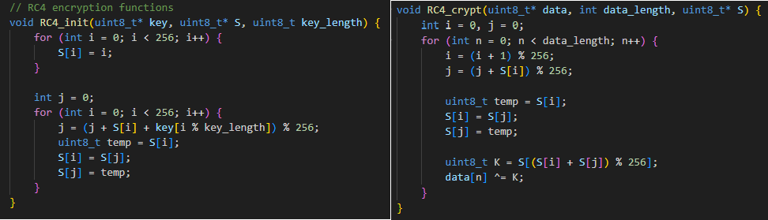
Algorithm

Slide 8
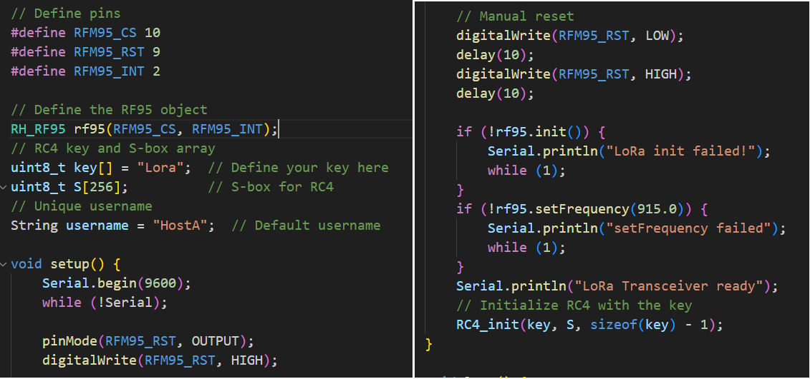
Arduino Lora Code

Slide 9
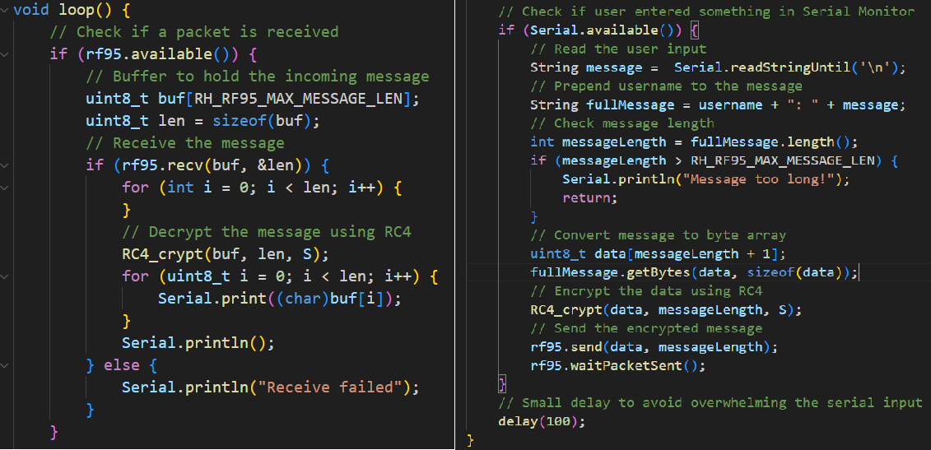
Arduino Lora Code

Slide 10

Results

Slide 11
Conclusion
In conclusion, the project successfully developed a LoRa-based messaging system designed for underground mining. This system addresses the challenges of terrain interference and dense rock formations by leveraging LoRa technology's ability to provide secure real-time communication. The use of the RC4 stream cipher ensures that messages are encrypted, providing necessary security while maintaining efficiency within the system's limited resources. Additionally, the project incorporated a user-friendly graphical interface to manage the transmission and reception of messages, enhancing the usability for operators in mining environments. Overall, the system proves to be a reliable solution for secure underground communication.

Slide 12
Q&A Session
THANK YOU

